Slide 1

Editable Label Generation
Prepared by Northwestern University MLDS
On Behalf of Zebra Technologies

Slide 2
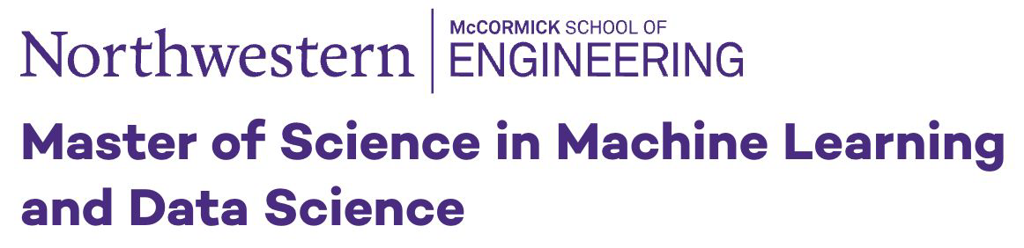
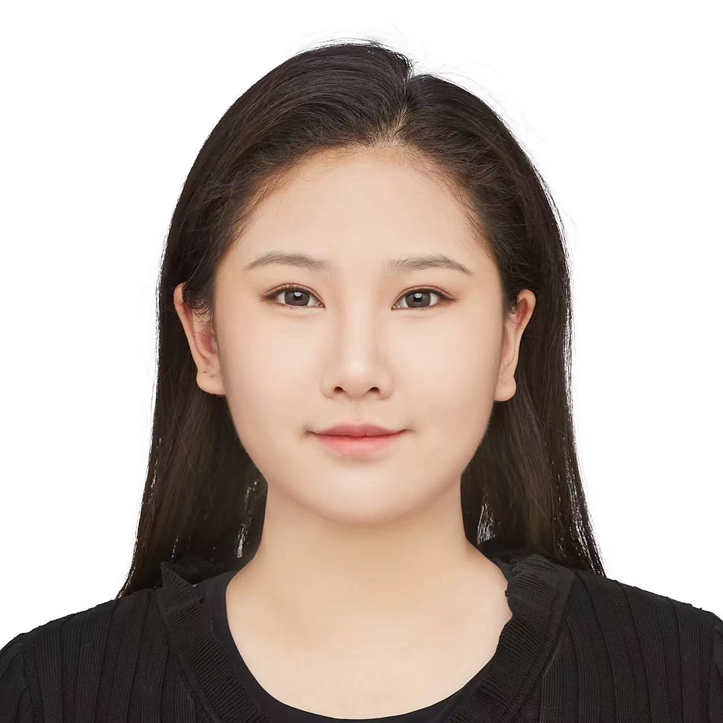




Meet Northwestern MLDS Team
Zhuoyan Liu
Inu Tenneti
Darwin Ye
Yumin Zhang

Slide 3
Agenda
01 - Introduction
Objectives & Business Opportunities
02 - Process Workflow
03 - Model Explanation
Object Detection (YOLO)
OCR (Pytessract)
Barcode Recogniation (Pyzbar)
04 - ZPL code generation
Feed Model Outputs to LLM

Slide 4

Introduction

Slide 5
Project Overview
Objective: Develop an automated pipeline to generate ZPL labels using object detection, OCR, and barcode recognition.
Key Tasks:
Train a YOLO model to detect Text, Barcode, and Figures from images.
Perform data augmentation to address class imbalance and improve model generalization.
Integrate Optical Character Recognition (OCR) and barcode decoding for metadata extraction.
Utilize bounding box outputs to generate ZPL code through API interactions.

Slide 6
Process Workflow

Slide 7
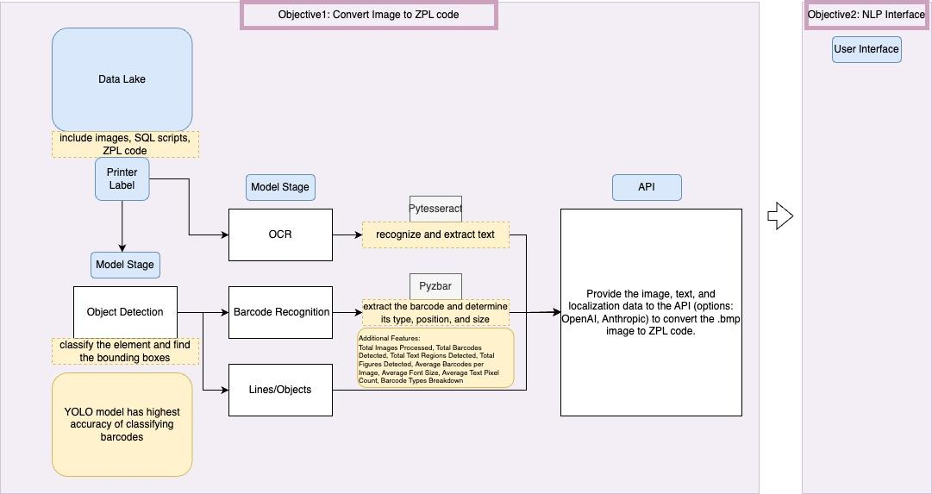

Slide 8
Model Explanation

Slide 9
Part 1: Image Detection using YOLO

Slide 10
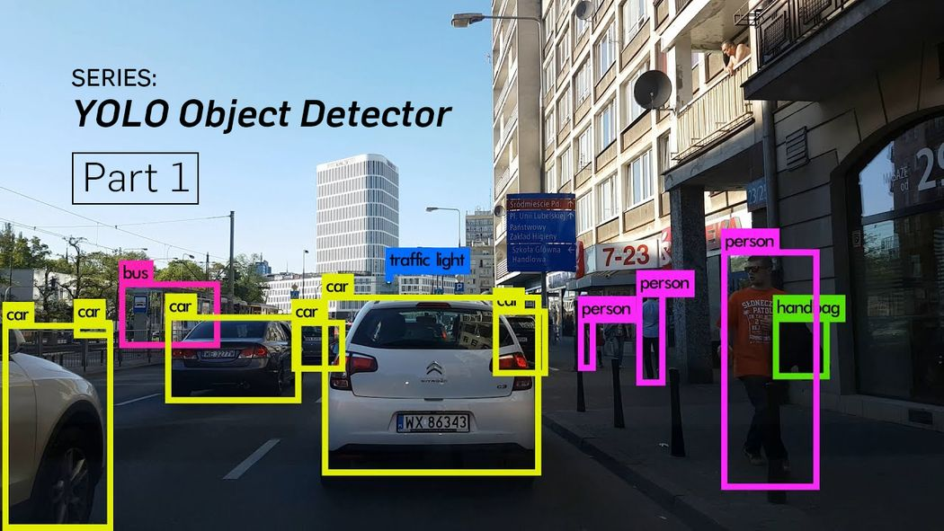
Object Detection
Objective:
Automate object detection for ZPL label generation.
Train a YOLO model to classify text, barcodes, and figures accurately.
Generate labels for test data that can be used for next steps
Key Tasks:
Data preparation, training, augmentation, evaluation, and predictions.
Compare model performance with and without data augmentation.
Tools Used:
LabelImg - Local Software to create bounding boxes
YOLO (You Only Look Once) - algorithm that uses a single neural network to detect objects and make predictions of bounding boxes that can classify objects

Slide 11
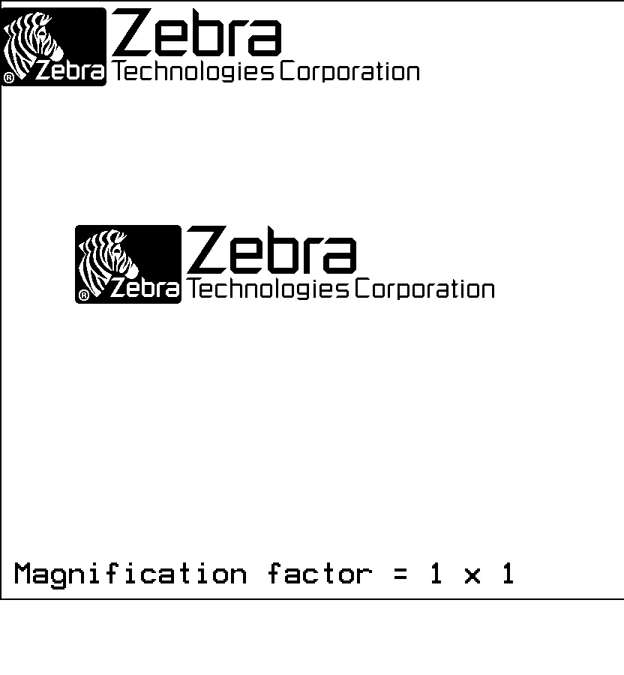
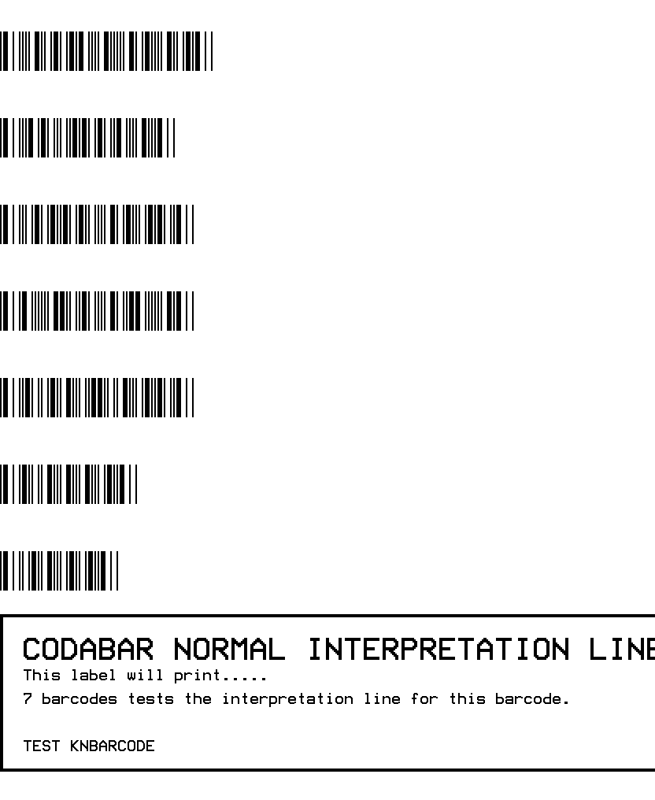
Dataset Overview
Total Number of Images in Original Dataset: 1494 images (.bmp files)
Subset of Data Used: 400 images
Train: 280 images, Val: 60 images, Test: 60 images
Classes: Text, Barcode, Figures
Data Challenges:
Imbalanced classes.
Smaller datasets requiring augmentation.
Examples of Data

Slide 12
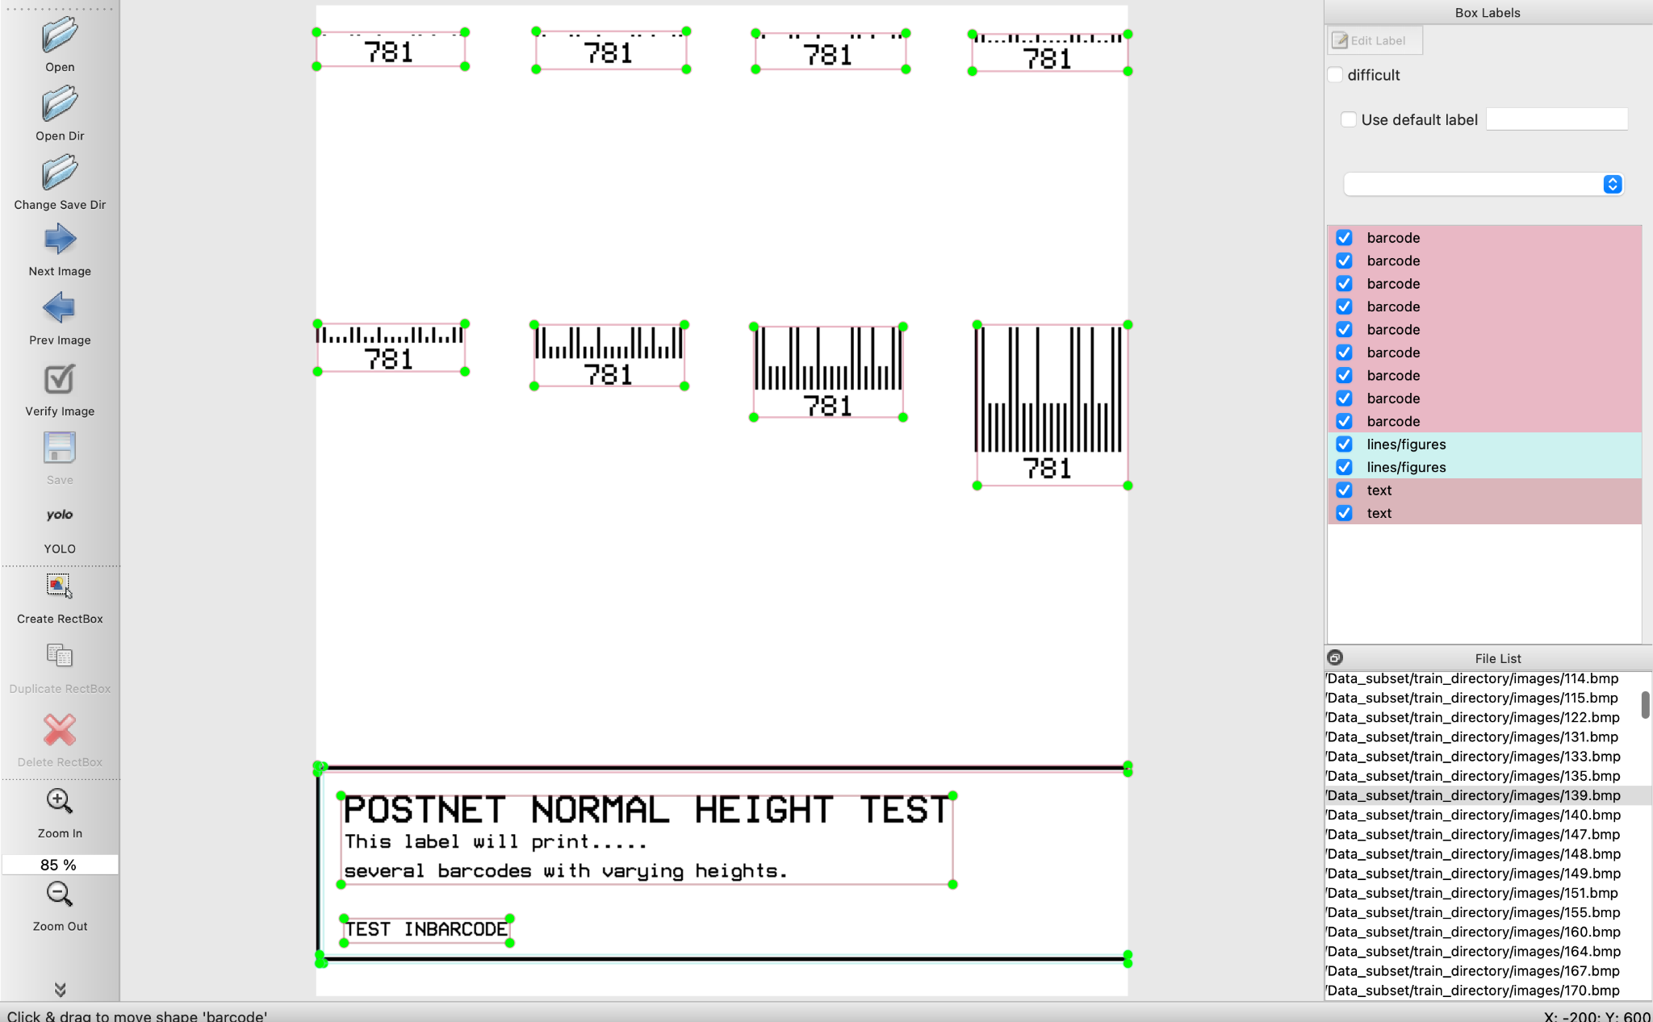
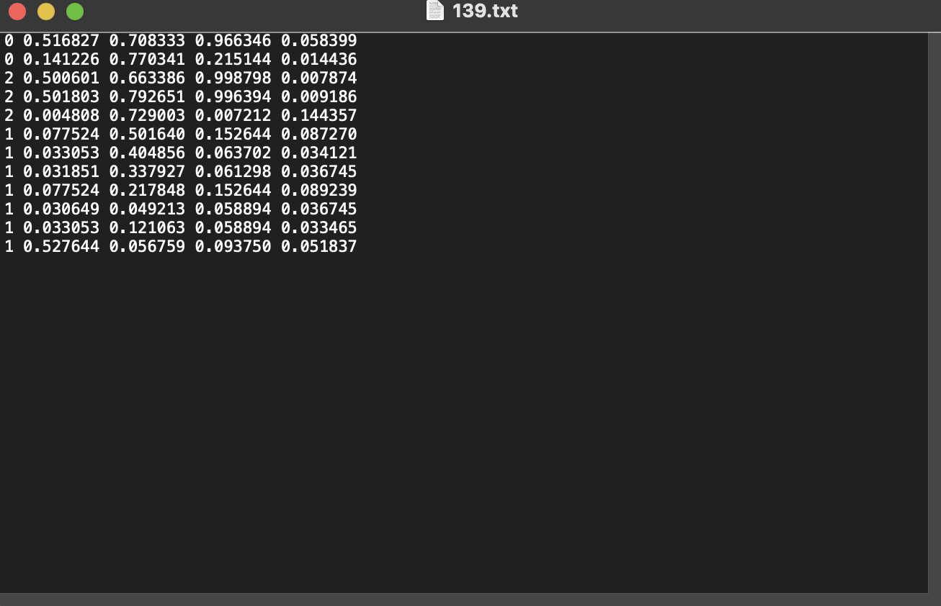
Labeling and Bounding Boxes
LabelImg Bounding Box Example
Bounding Box Annotation:
Used LabelImg to annotate the dataset.
Bounding boxes created in YOLO format: [class_id, x_center, y_center, width, height].
After bounding boxes were saved, a .txt file is produced and saved under labels for each image
Challenges:
Ensuring bounding boxes align with augmented images.
Handling edge cases like small bounding boxes or overlapping objects.
Bounding Box Validation:
Checked bounding box ranges (0 < x, y, w, h ≤ 1) after augmentations.

Slide 13
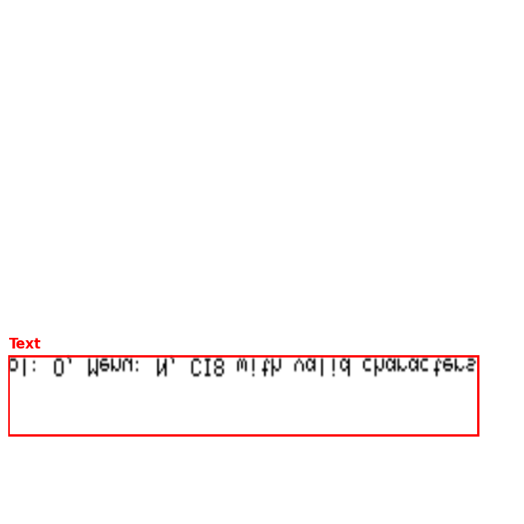
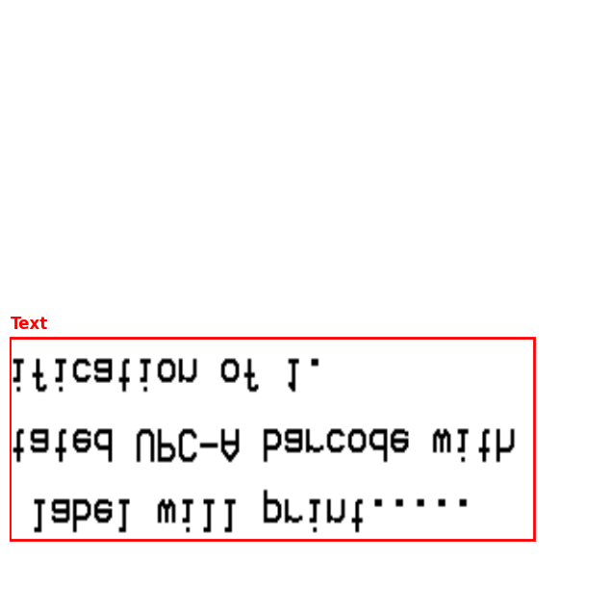
Data Augmentation
Reason:
Performed data augmentation on training data to feed more types of images into the model so it can perform better
Augmentation Techniques:
Horizontal and vertical flips.
Random brightness and contrast adjustments.
Rotation and resized crops.
Implementation Details:
Used albumentations for augmentation.
YOLO bounding box adjustment after augmentation.
Outcome:
Added X augmented images to training data.
Increased dataset diversity.
Examples of Augmented Image

Slide 14
YOLO Model
Implemented multiple YOLO models with different attribute in order to achieve optimal results
Types of YOLO Models Used
Model Info
Results
1
Baseline YOLO Model w/ pre-trained weights yolov5s.pt
Established baseline performance for comparison with subsequent models.
Model had difficulty distinguishing between classes - had highest accuracy with barcodes and lowest with figures/lines
2
YOLO Model w/ Focal Loss
Introduced Focal Loss to address class imbalance by penalizing well-classified examples.
Model identified lines/figures slightly better
3
YOLO Model w/ Hybrid Loss
Combined Cross-Entropy Loss and Focal Loss into a Hybrid Loss Function for balanced learning.
Model’s results did not change from previous results
4
YOLO Model w/ Augmented Dataset
Enhanced training with Albumentations-based Data Augmentation.
Model was able to distinguish between figures and backgrounds better and text detection accuracy improved

Slide 15
Utilizing the Model
Chose Model that performed best on test data - YOLO w/Augmented Dataset
Evaluated ground truth vs predictions made by the model in order to determine model performance
Save bounding box coordinates from test predictions and utilized those labels for next step
1
3
5
2
4
Ran predictions on the validation dataset and saved bounding box coordinates and class predictions
Ran YOLO w/ Augmented Dataset predictions on the test dataset

Slide 16
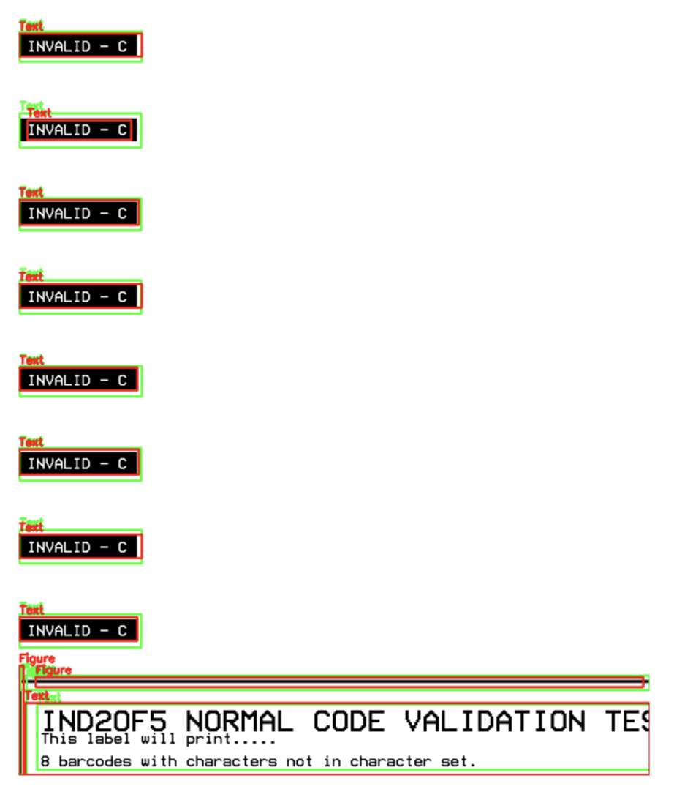
Results
Key:
Green = ground truth
Red = prediction
Classification Accuracy: 0.53 (53%)
Despite lower Accuracy score the model is still providing valuable output for next steps - due to better barcode and text classification. The class imbalance with figures (despite data augmentation) is causing the model to have trouble with classifying figures.
Areas for Improvement:
More data augmentation or choose a subset of data that has more figures.
Conduct more hyper-parameter tuning
Experiment with larger YOLO models
Certain barcodes/figures were too small for model to interpret accurately so identifying problem images and tailoring the model to handle these errors

Slide 17
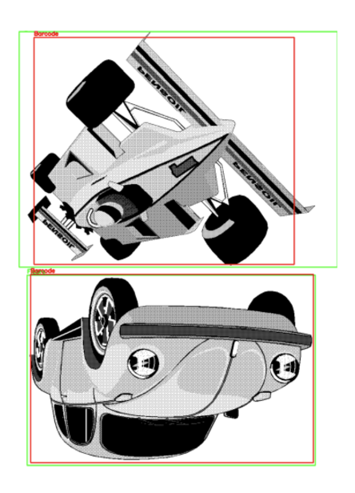
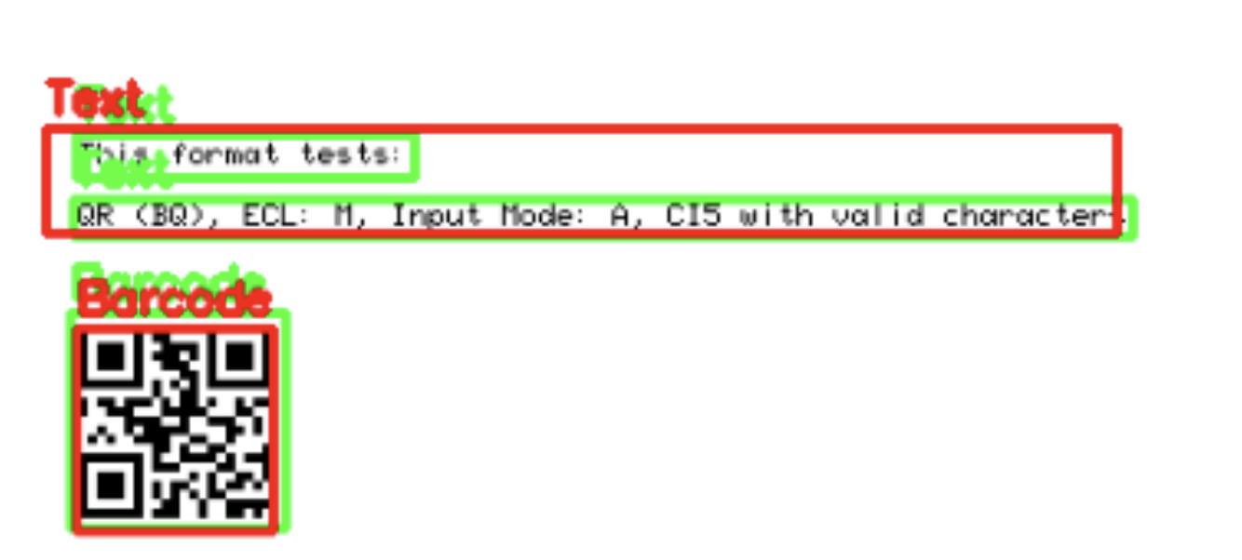
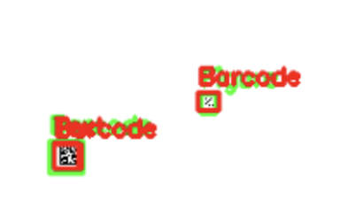
Examples

Slide 18
Part 2: Optical Character Recognition

Slide 19
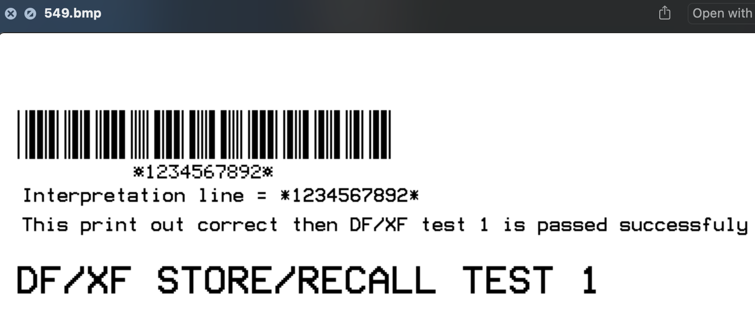
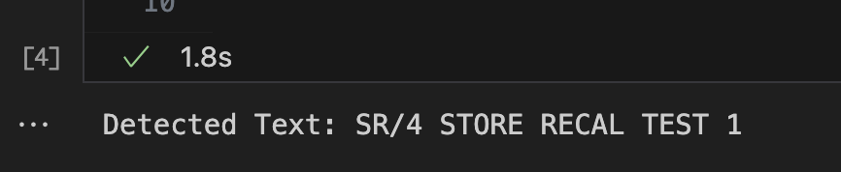
TrOCR
What is TrOCR?
Transformer-based OCR model pretrained on large-scale datasets for robust text recognition.
Pros:
High Accuracy on Simple Layouts:
Performs well on clean, high-quality images with clear text regions.
Contextual Understanding:
Leverages transformer architecture to handle contextual relationships in text.
Adaptability:
Potential for fine-tuning on custom datasets for domain-specific text recognition.
Cons:
Complex Layout Limitations:
Struggles with multi-region text and overlapping bounding boxes.
Font Variability Issues:
Inconsistent performance with varying font styles and sizes.
Pretrained Limitations:
Pretraining on general datasets leads to suboptimal results for specialized tasks (e.g., barcode label text).
Resource Intensive:
Requires significant computational resources for fine-tuning and inference.
Notes:
TrOCR is a transformer-base OCR developed by Microsoft, known as one of the best OCR models.

Slide 20
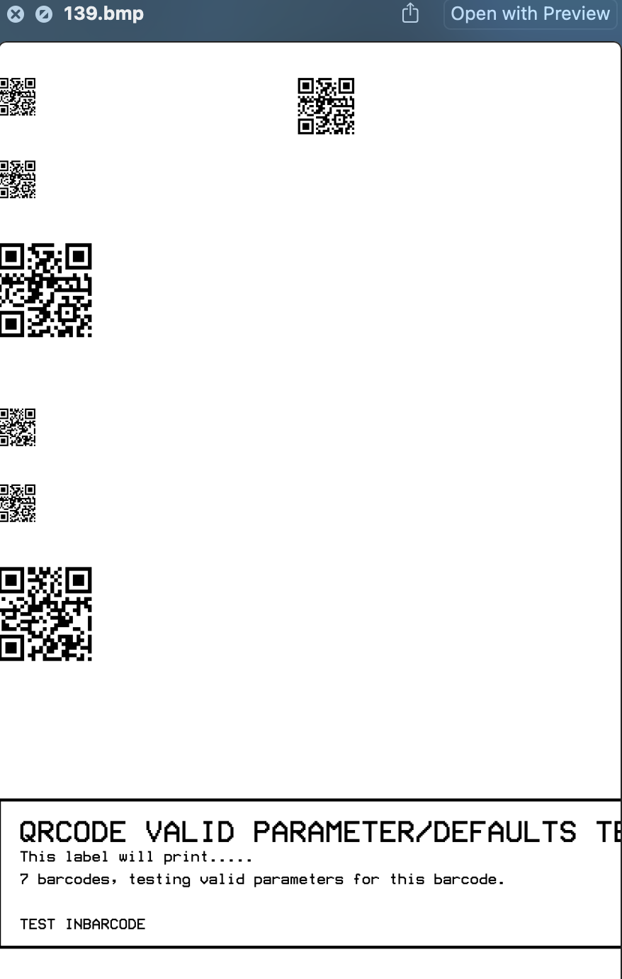
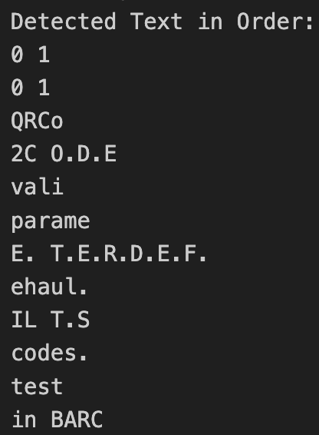
EAST
What is EAST?
Efficient and Accurate Scene Text Detector:
Detects text regions by generating rotated bounding boxes and quadrilaterals.
Text Localization Focus:
Primarily designed for identifying the location of text, not for recognizing it.
Pros:
High Precision for Scene Text:
Works well in identifying text regions in natural images, even for irregular layouts.
Rotated Text Detection:
Handles rotated and skewed text effectively.
Lightweight and Fast:
Computationally efficient and easy to integrate with recognition models like PyTesseract.
Cons:
Not a Recognition Model:
Focused on localization, requiring an additional OCR model for text recognition.
Inconsistent Bounding Boxes:
Generates multiple or overlapping boxes for dense text regions.
Small Region Challenges:
Struggles to accurately localize very small text areas.
Problems in My Case:
Dense Text Regions:
Overlapping or clustered text regions on barcode labels result in multiple bounding boxes for a single line of text.
Complex Layouts:
Difficulty in detecting text near or within barcode areas due to limited differentiation.
Bounding Box Mismatch:
Detected regions often do not align perfectly with the actual text, leading to recognition errors in downstream OCR.

Slide 21
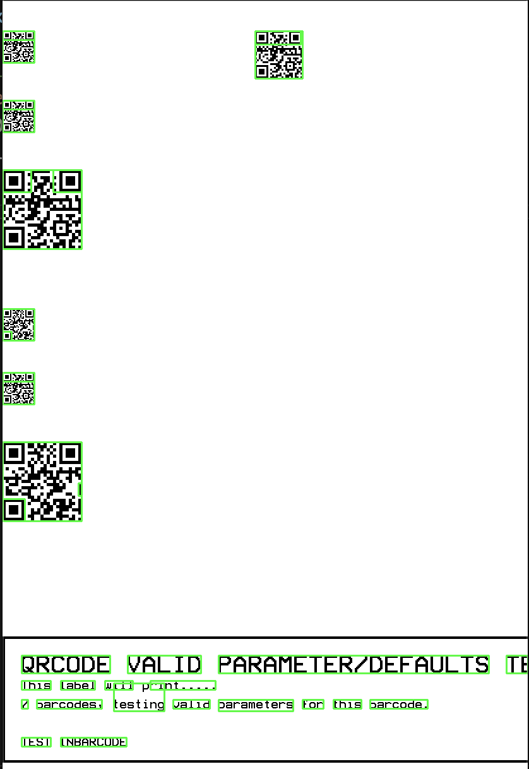
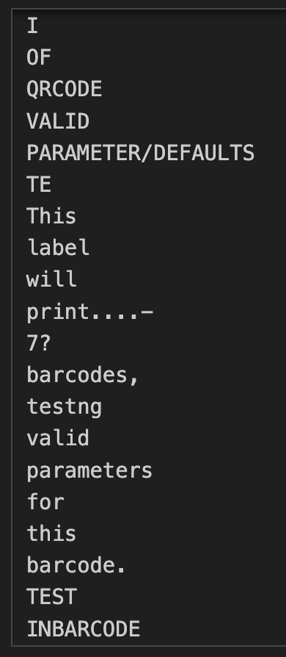
Pytesseract
What is PyTesseract?
Python wrapper for Google's Tesseract-OCR, ideal for lightweight OCR tasks.
Pros:
Easy integration and fast processing.
Configurable settings (--psm, --oem) for multi-region text detection.
Effective with preprocessing (e.g., masking barcodes, enhancing contrast).
Multi-language support for diverse use cases.
Cons:
Limited contextual understanding compared to deep learning models.
Sensitive to font and layout variations.
Struggles with dense text and barcode interference (e.g., misreads numbers under barcodes).
Why Use PyTesseract?
Flexible and efficient for preprocessed images.
Lightweight alternative to resource-intensive models like TrOCR.
Notes:
Pytesseract is a Python wrapper for Google’s Tesseract-OCR engine.
Provides both text localization and recognition, delivering accurate results for multi-region and multi-font text.
Achieves performance that is twice as fast as the combination of EAST and TrOCR.
Effectively processes images when paired with libraries like OpenCV for tasks such as thresholding, resizing, and noise reduction.
Supports fine-tuning through customizable Tesseract configuration parameters.

Slide 22
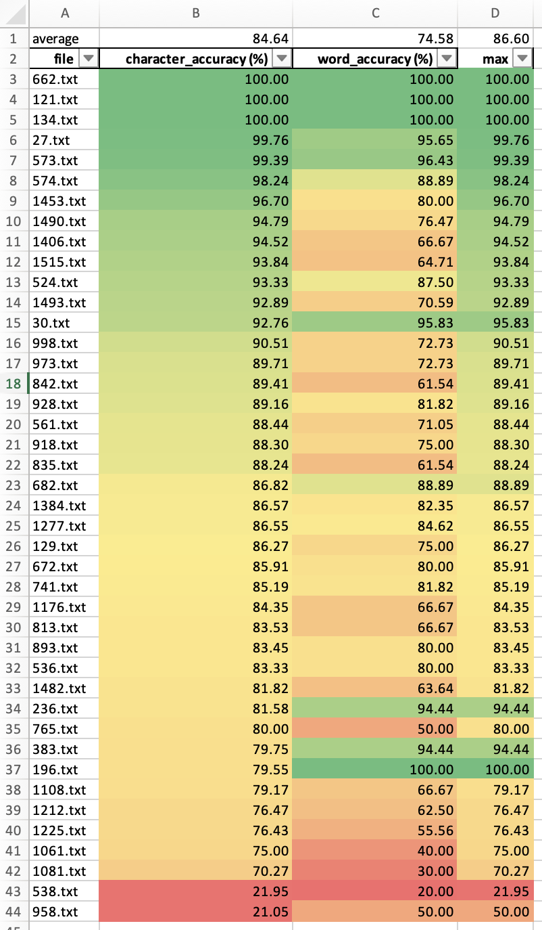
Character Accuracy
Character accuracy measures how closely the OCR output matches the ground truth at the character level. It considers the Levenshtein Distance (Edit Distance) to account for insertions, deletions, and substitutions.
Character Accuracy (%) = (1− D/N​ ) ×100
Where:
DDD: Edit Distance – The minimum number of insertions, deletions, or substitutions required to convert the OCR output into the ground truth text.
NNN: Length of Ground Truth – The total number of characters in the ground truth text.
Word Accuracy
Word accuracy measures how many words in the OCR output match exactly with the words in the ground truth text.
Word Accuracy (%)= (Number of Correct Words / Total Words in Ground Truth) ​×100
Where:
Correct Words: Words in the OCR output that match exactly with the words in the ground truth text.
Total Words in Ground Truth: Total number of words in the ground truth text.

Slide 23
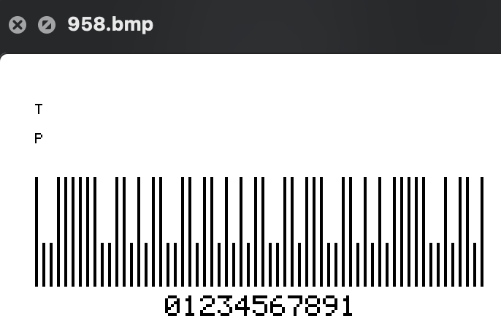
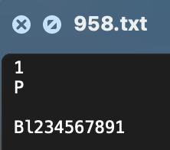
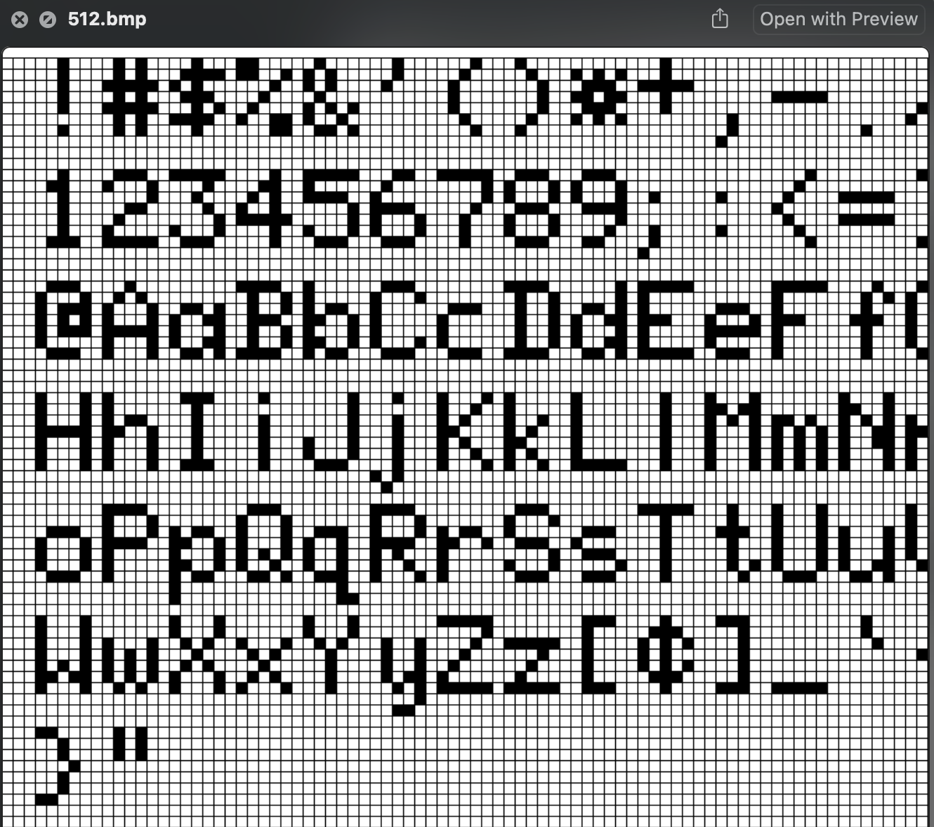
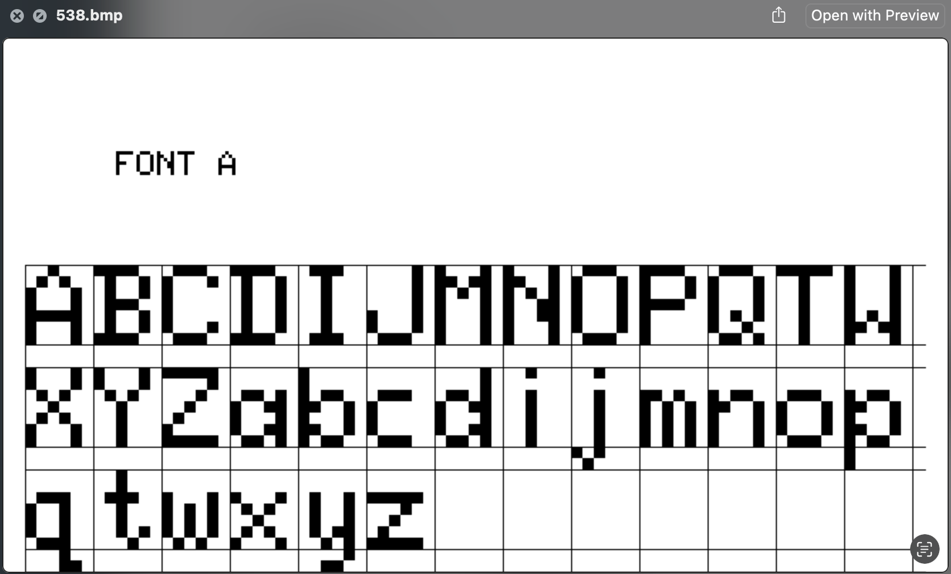
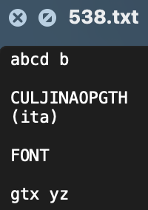

Slide 24
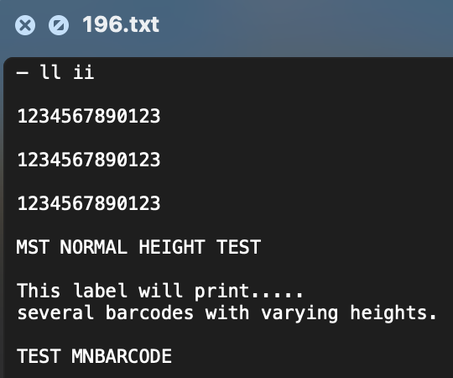
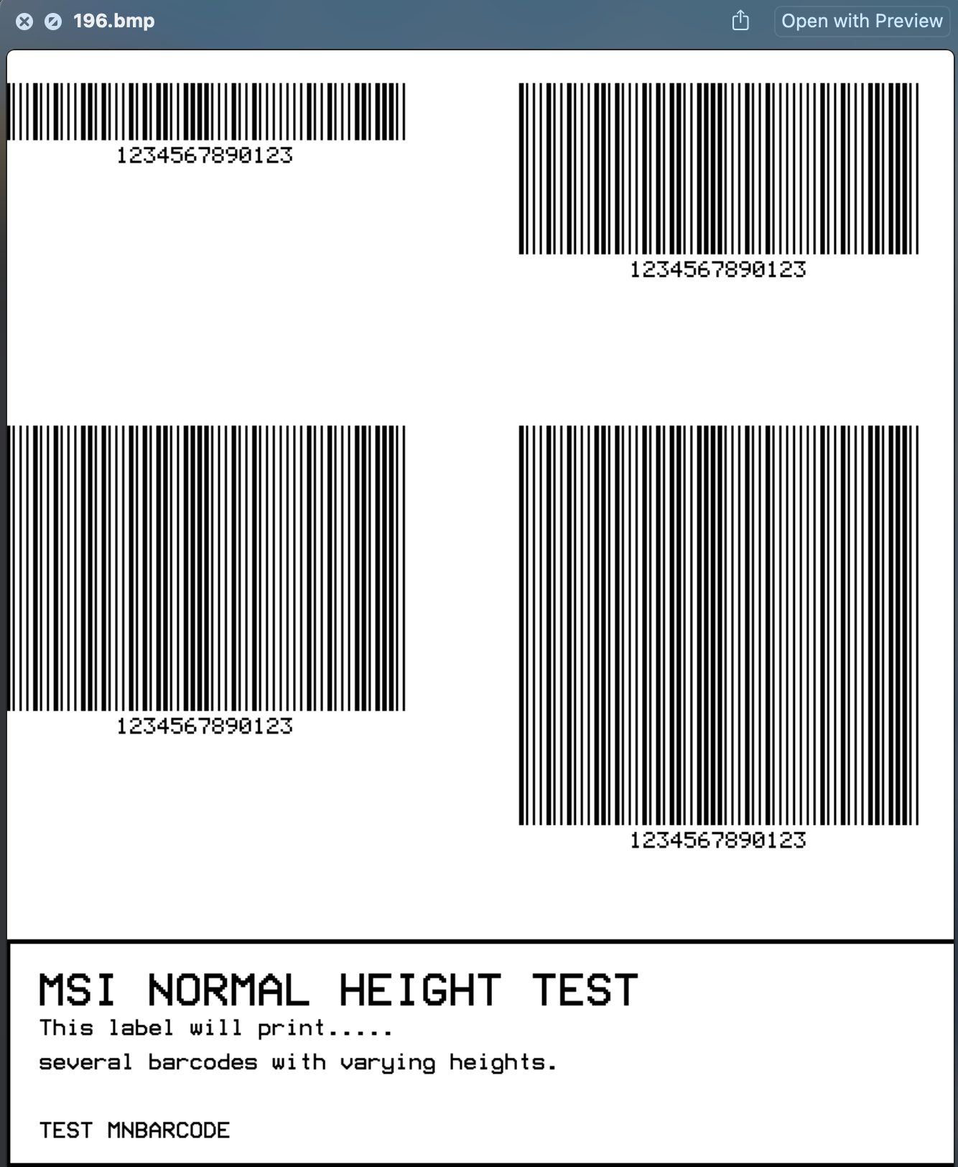
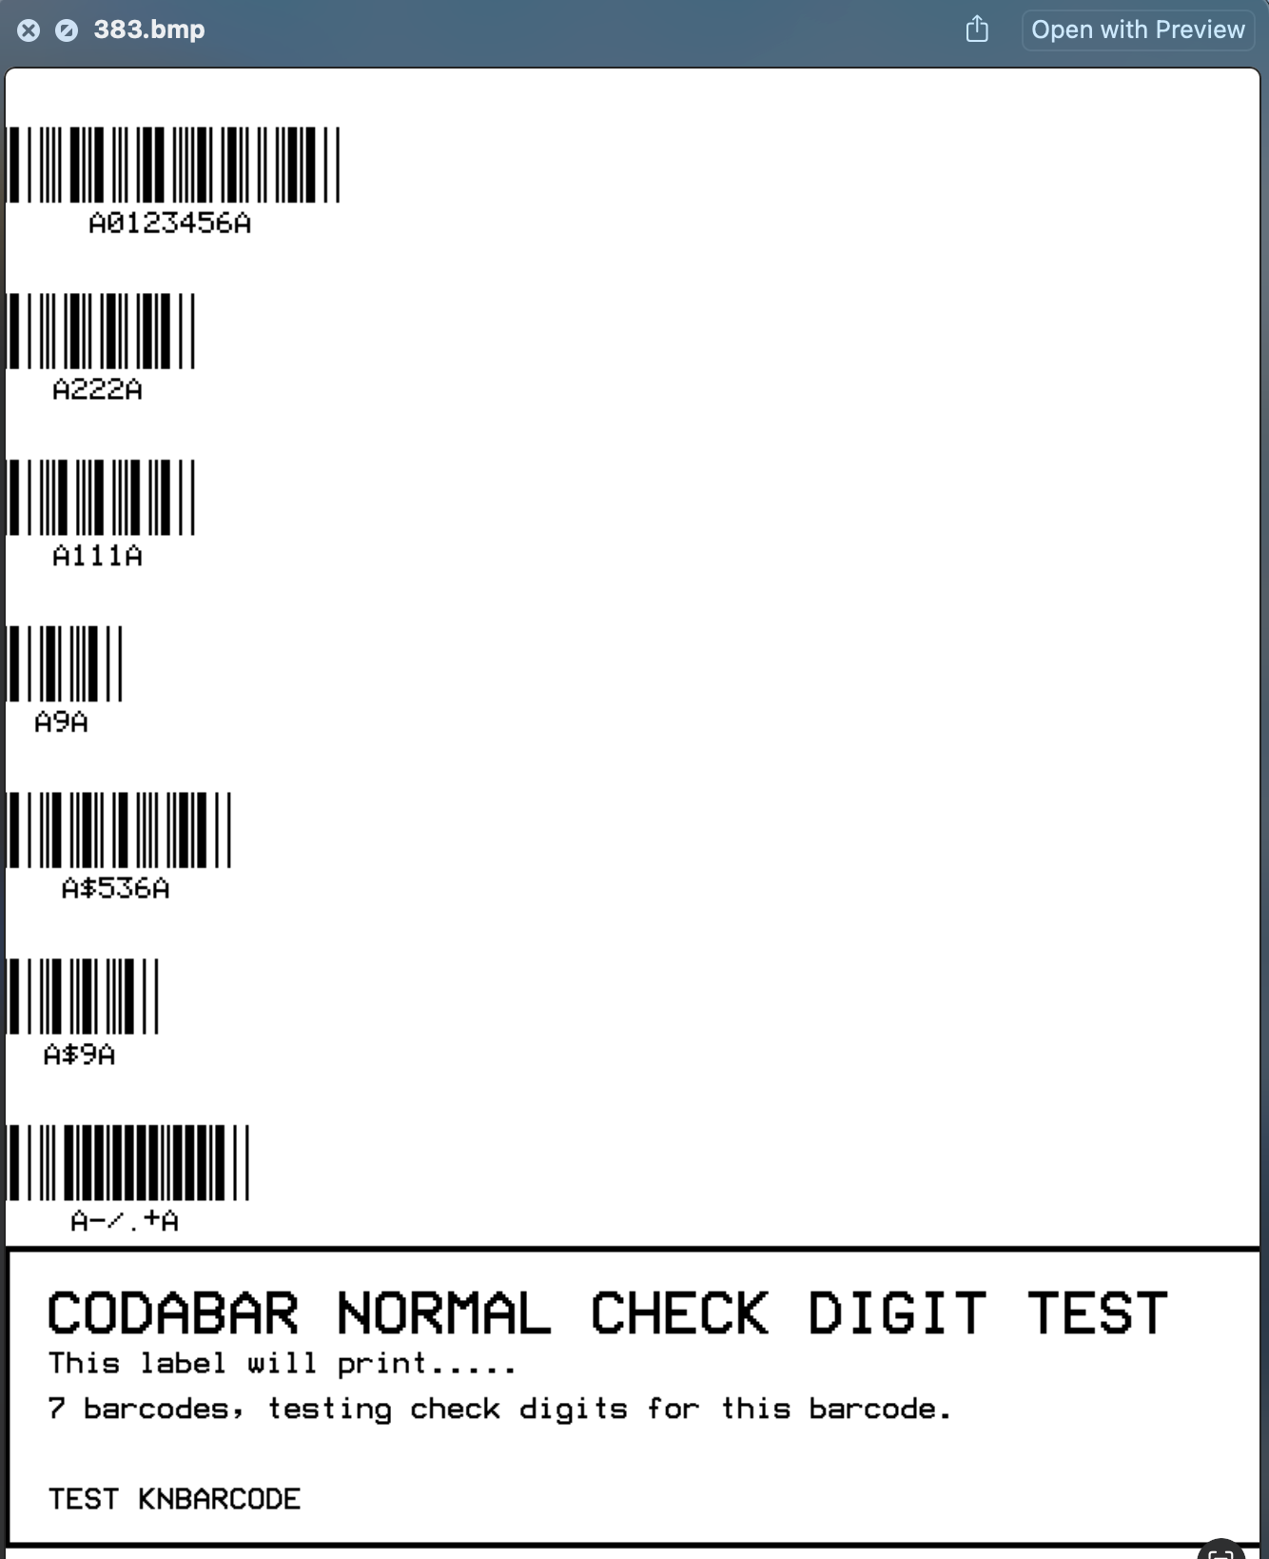
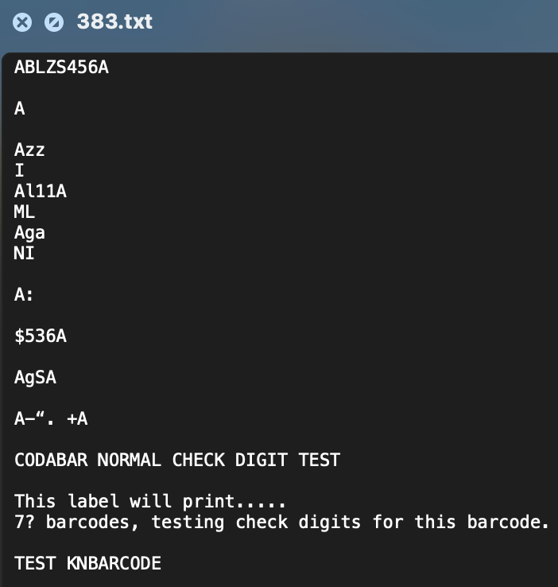

Slide 25
Future Recommendations
Train the TrOCR + EAST with ground truth
Use bounding box to locate barcode region
White out the barcode region before passing to OCR

Slide 26
Part 3: Image Recognition

Slide 27
Image Recognition Overview
Project Architecture
Input Processing: Uses YOLO model output for bounding box coordinates of detected barcodes, text, and figures in BMP images
Technology Stack: OpenCV (cv2) for image processing, pyzbar for barcode decoding, and JSON handling for annotation data
Output: Generates detailed analysis files for each image and a comprehensive summary report
Key Features:
• Automated barcode detection and classification
• Text region analysis with font metrics
• Figure detection and tracking
• Statistical analysis of detected elements

Slide 29
Output Analysis
Per-Image Output
• Barcode type and content
• Text region metrics
• Figure locations
• Bounding box coordinates
Summary Statistics
• Total elements detected
• Average barcodes per image
• Font size distributions
• Barcode type breakdown
Output Directory Structure:
• Individual .txt files for each processed image
• Comprehensive summary.txt with aggregate statistics

Slide 30
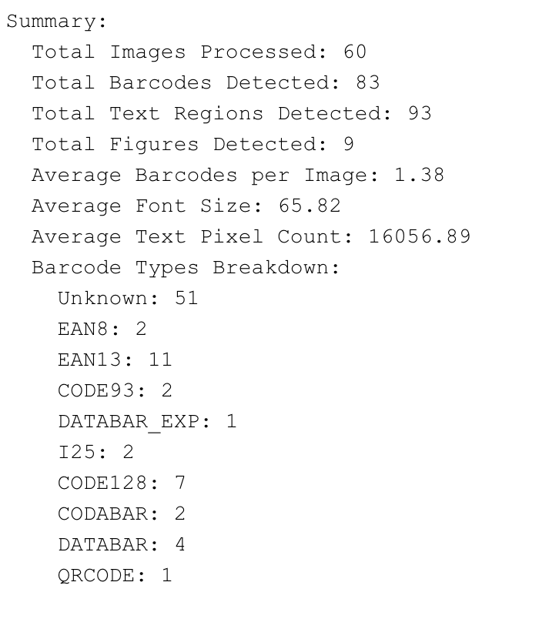
Project Results

Slide 31
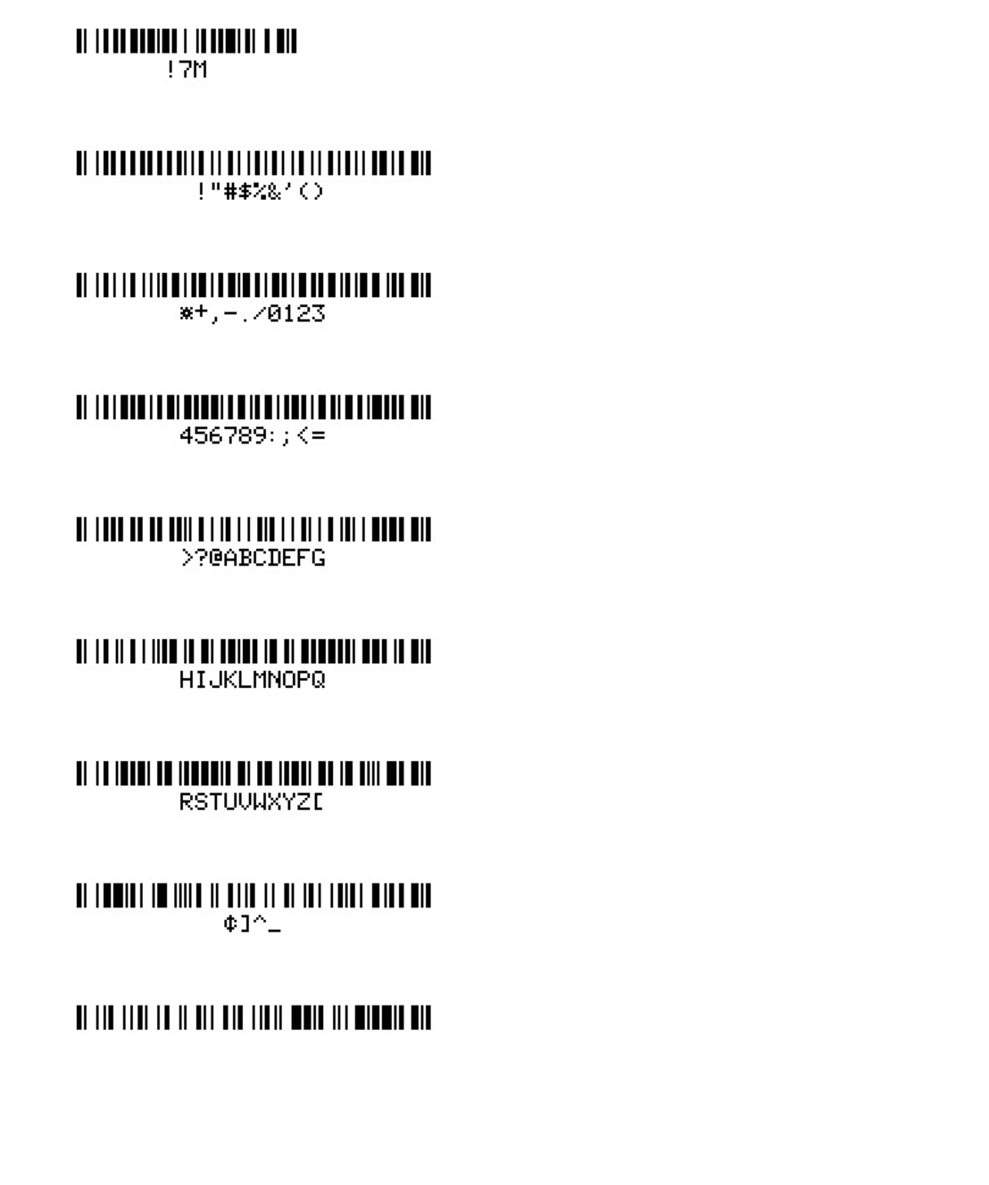
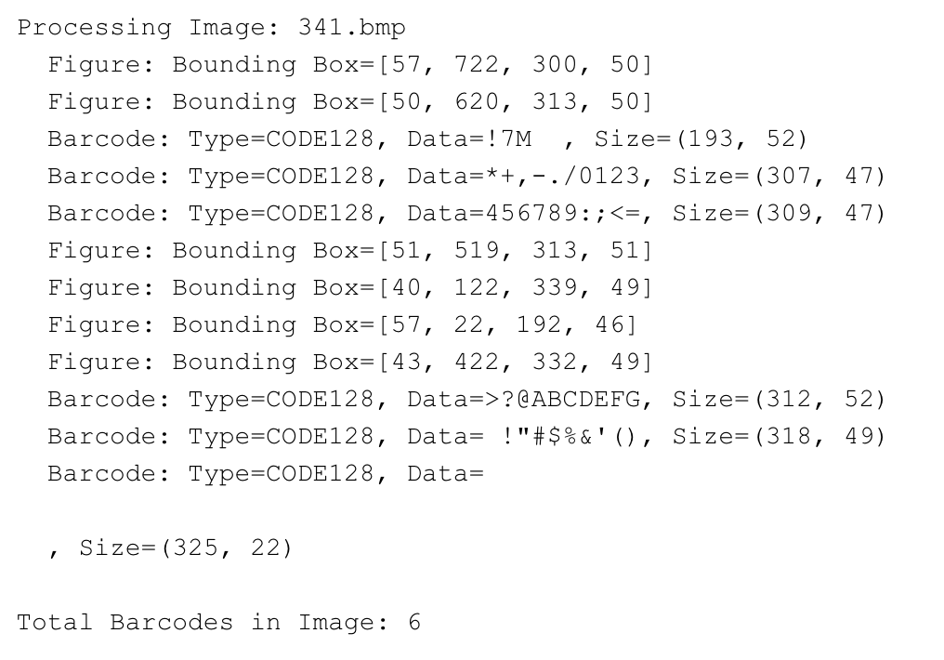
Example Output

Slide 32
Undetectable Barcode Examples

Slide 33
Known Limitations and Challenges
Barcode Detection Issues
• High rate of unknown barcodes (51 out of 83 detected)
• Varied success rates across different barcode types
Technical Constraints
• pyzbar library limitations for certain barcode formats
• Challenges with high-density barcodes (DATABAR, DATABAR_EXP)
Suggested Improvements
• Implement additional barcode decoding / font libraries
• Enhanced preprocessing for unknown barcode types

Slide 34
Feed Information to API and ZPL Code Generation

Slide 35
Overview of API Exploration
Goal: To identify the most effective API for generating ZPL code from input data (bounding box, OCR, and barcode data).
Initial APIs Tested:
OpenAI API (gpt-4o): Performed well in initial trials.
Anthropic API (claude-3-5-sonnet): Explored but showed less promising results.
Decision: After comparative analysis, OpenAI API was chosen for its superior performance.

Slide 36
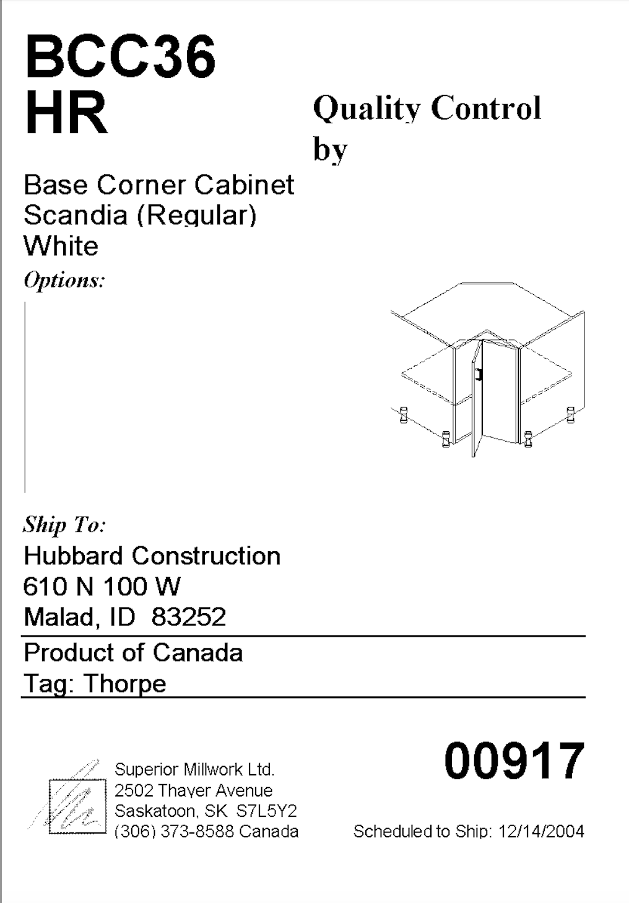
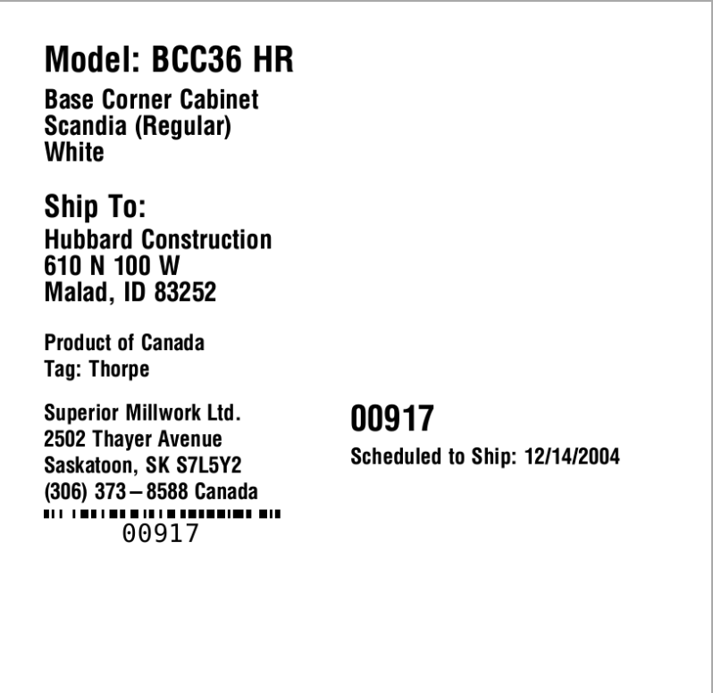
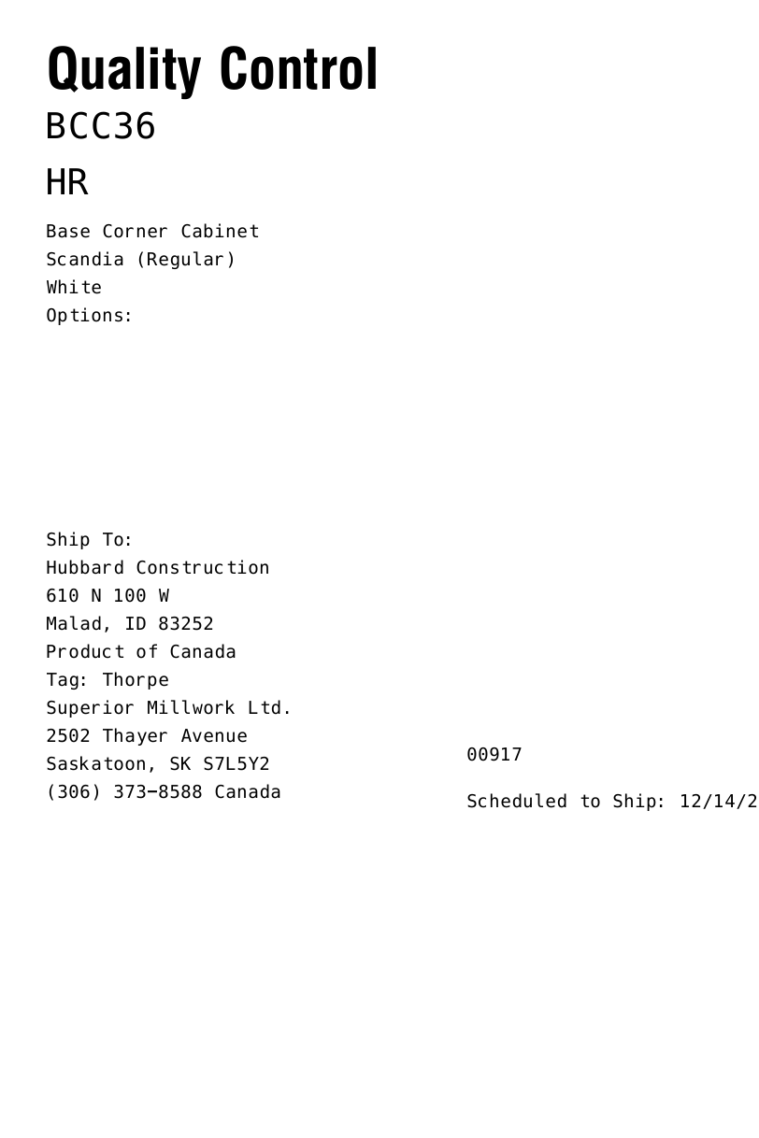

Slide 37
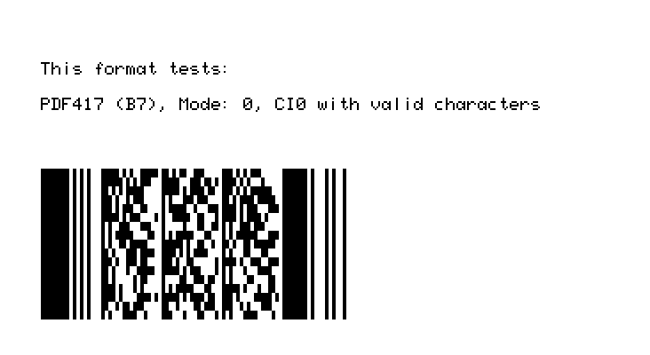
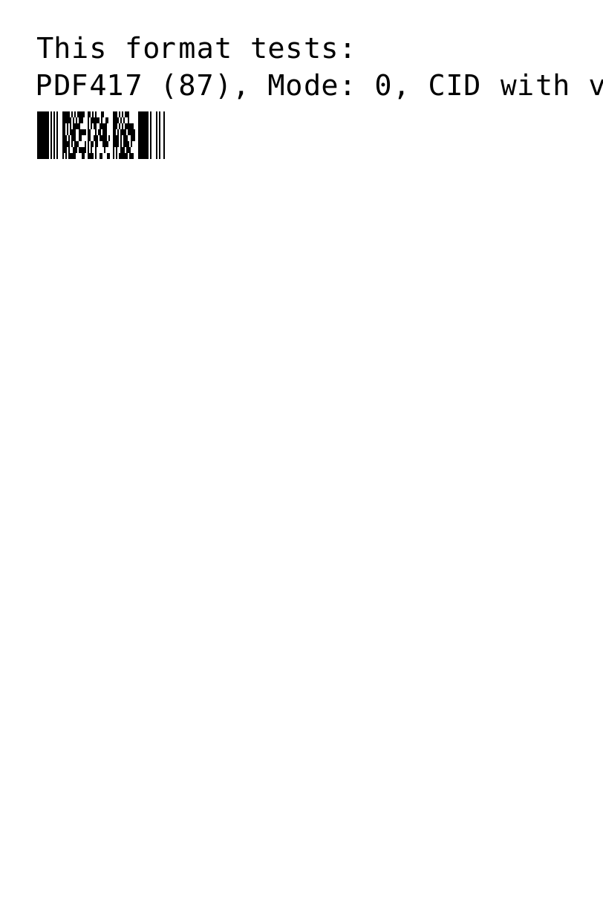
API generated ZPL code (baseline)
Input image:
prompt = "please detect the metadata (e.g., text, figure, barcode, and other information) in this figure, and then generate the ZPL code based on the detected metadata"
ZPL code generated:
^XA
^FO50,50^ADN,36,20^FDThis format tests:^FS
^FO50,100^ADN,36,20^FDPDF417 (87), Mode: 0, CID with valid characters^FS
^FO50,150^B7N,8,10^FD1234567890^FS
^XZ
Generated image:

Slide 38
Improving with Bounding Box Information
Challenge Identified:
The baseline prompt lacked contextual information regarding object placement.
Improvement:
Introduced bounding box coordinates into the prompt to provide spatial context.
Result:
Enhanced precision in the generated ZPL code, making outputs put in more accurate position

Slide 39
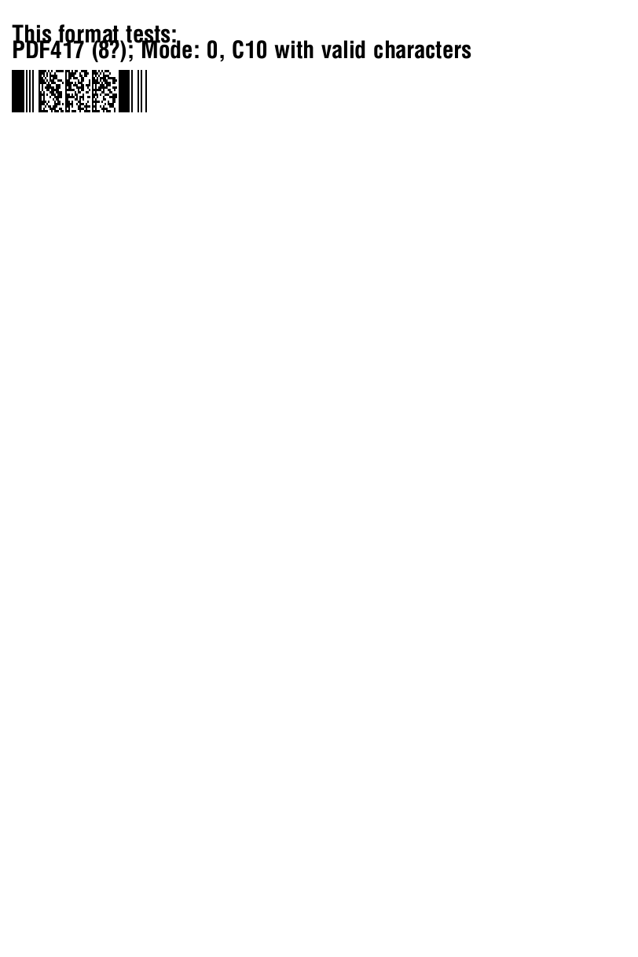
API generated ZPL code (with bounding box info)
Input image:
ZPL code generated:
^XA
^FO15,32^A0N,30,30^FDThis format tests:^FS
^FO15,52^A0N,30,30^FDPDF417 (8?); Mode: 0, C10 with valid characters^FS
^FO15,89^BY2^B7N,3,10,,N^FD<The Barcode Data Here>^FS
^XZ
prompt = """please do the following steps to generate the ZPL code:
1/ detect the metadata in the uploaded image, including text, figure, barcode, and other information.
2/ Assign the coordinates to the detected metadata using the json_data. Do not use the "class". Only use the "bbox" for the coordinates of a metadata. The json file can contain less information than the bmp file, so do not rely on the json file.
3/ based on the detected metadata and bounding box for the metadata, generate the ZPL code.
"""

Slide 40
Incorporating Text Information
Challenge Identified:
The API needed textual data to fully comprehend label content.
Solution:
Supplemented the prompt with both bounding box and text information.
Result:
Improved understanding of label content, resulting in better alignment and positioning in the ZPL output.

Slide 41
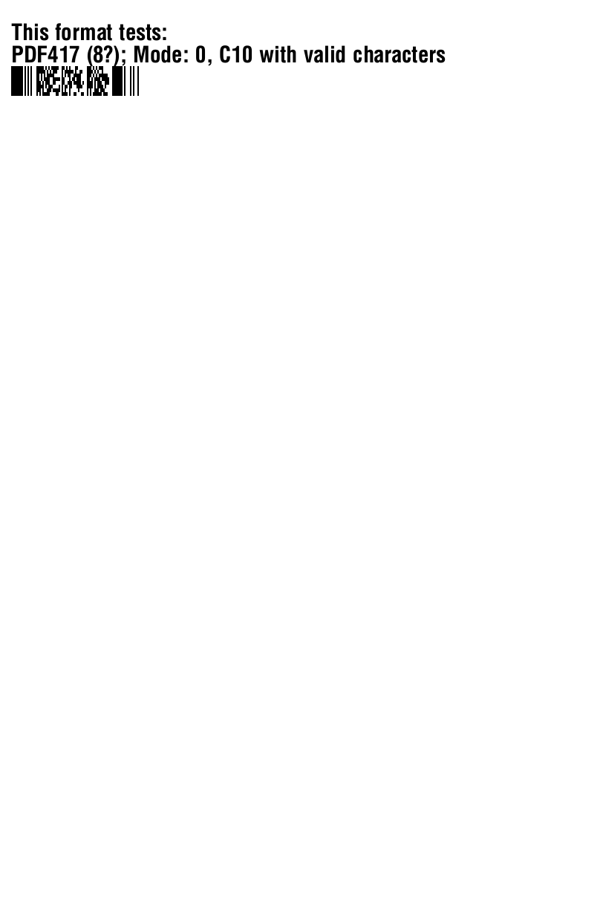
API generated ZPL code (with bounding box and text)
Input image:
prompt = """please do the following steps to generate the ZPL code:
1/ detect the metadata in the uploaded image, including text, figure, barcode, and other information.
2/ make sure the text in the detected metadata is the same as the text_data. If they are not the same, use the text_data.
3/ Assign the coordinates to the detected metadata using the json_data. Do not use the "class". Only use the "bbox" for the coordinates of a metadata. The json file can contain less information than the bmp file, so do not rely on the json file.
4/ based on the detected metadata and bounding box for the metadata, generate the ZPL code.
"""
ZPL code generated:
^XA
^FO15,32^A0N,30,30^FDThis format tests:^FS
^FO15,62^A0N,30,30^FDPDF417 (8?); Mode: 0, C10 with valid characters^FS
^FO15,89^BY2
^B7N,5,200^FD1234567890^FS
^XZ

Slide 42
Enhancing Prompts with Barcode Data
Challenge Identified:
Missing barcode type and count in the prompt hindered ZPL output validation.
Solution:
Use Pyzbar to extract barcode type and count and include them in the API prompt.
Result:
Improved ZPL accuracy with validated barcode type and count, enhancing pipeline reliability.

Slide 43

API generated ZPL code (with bounding box, text and barcode)
Input image:
prompt = """please do the following steps to generate the ZPL code:
1/ detect the metadata in the uploaded image, including text, figure, barcode, and other information.
2/ make sure the text in the detected metadata is the same as the text_data. If they are not the same, use the text_data.
3/ the number of barcode you should detect in the metadata is barcode_number.
4/ Assign the coordinates to the detected metadata using the json_data. Do not use the "class". Only use the "bbox" for the coordinates of a metadata. The json file can contain less information than the bmp file, so do not rely on the json file.
5/ based on the detected metadata and bounding box for the metadata, generate the ZPL code.
"""
ZPL code generated:
^XA
^FO15,32^A0N,30,30^FDThis format tests:^FS
^FO15,62^A0N,30,30^FDPDF417 (8?); Mode: 0, C10 with valid characters^FS
^FO15,89^BY2
^B7N,5,200^FD1234567890^FS
^XZ

Slide 44
Key Learnings and Efforts
Incremental prompt engineering significantly improves API outputs.
The addition of bounding box and text data enhances contextual understanding.
Incorporating barcode information helps validate output accuracy, ensuring alignment with the expected label structure.

